Slide 1
Electronic Services

Slide 2
Electronic Online Services
Government Services.
E-commerce.
Financial services.
E transport services (uber, faras, ride-now)
E ticketE-cites

Slide 3
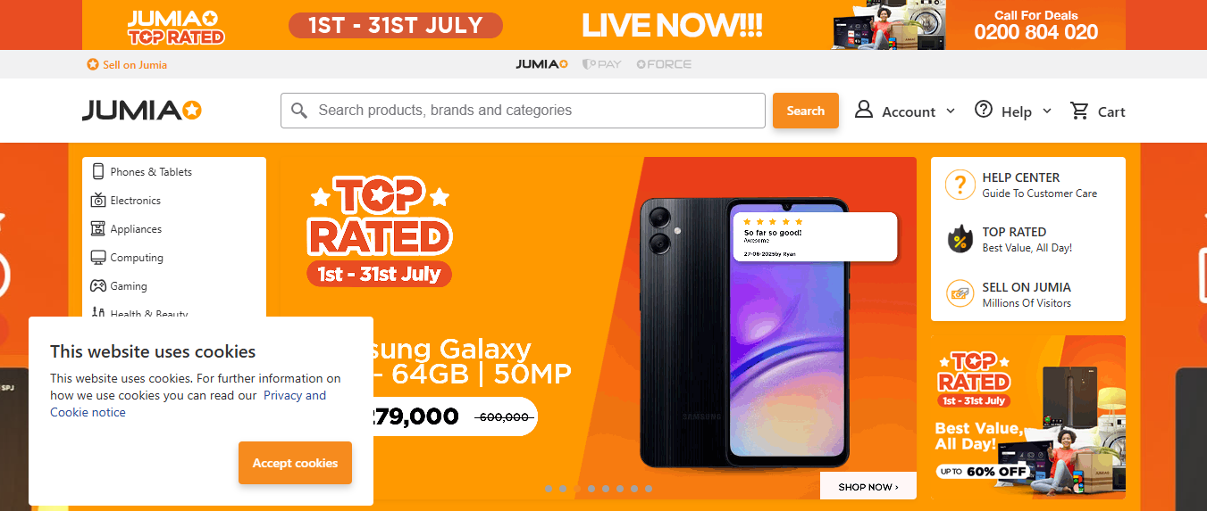
E-commerce
https://www.jumia.ug/

Slide 4
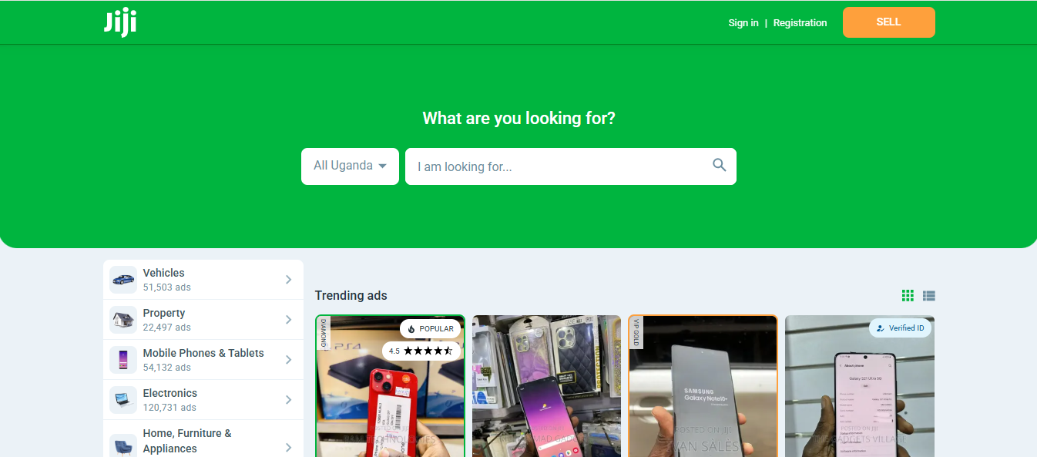
E-commerce
https://jiji.ug/

Slide 5
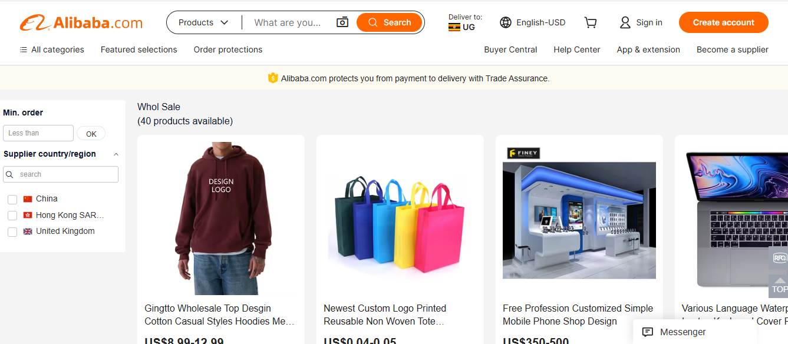
E-commerce
https://www.alibaba.com/

Slide 6
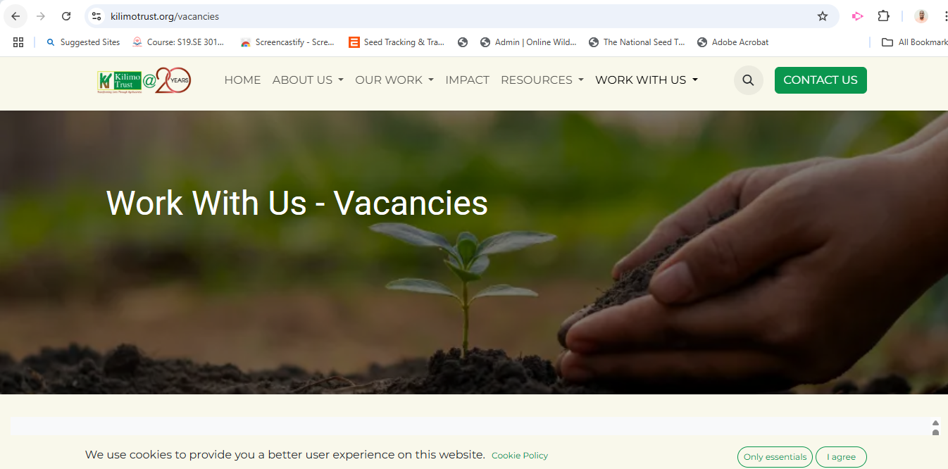
E-commerce
https://www.kilimotrust.org/

Slide 7
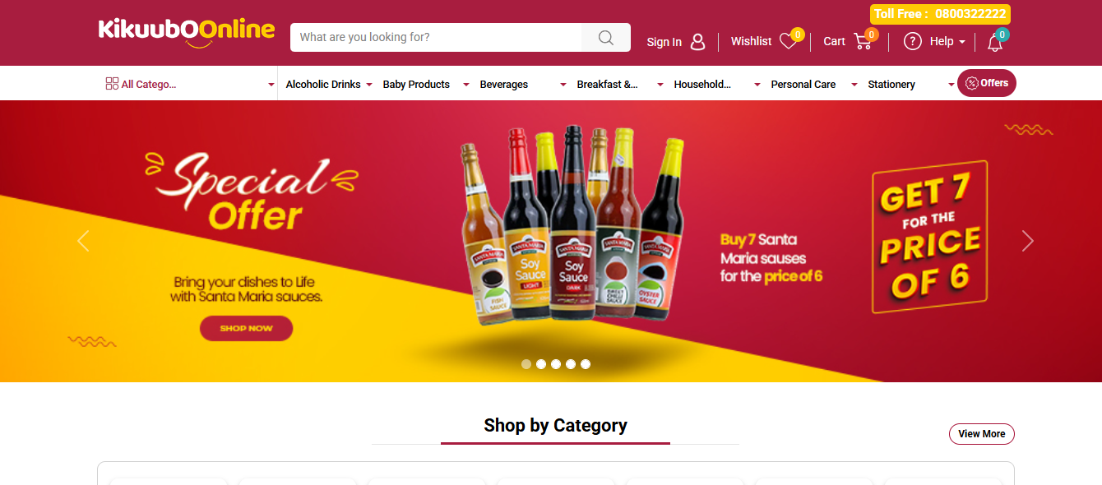
E-commerce
https://kikuuboonline.com/

Slide 8
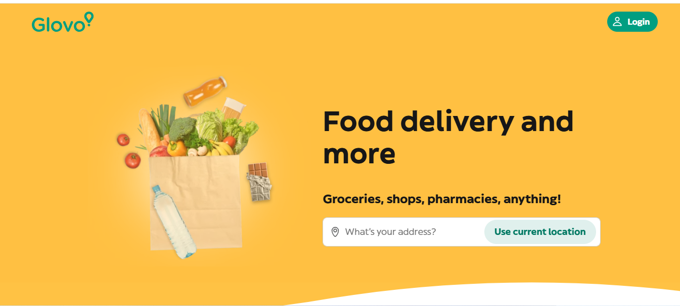
E-commerce
https://glovoapp.com/

Slide 9

E-commerce
https://cafejavas.co.ug/

Slide 10

Financial services
Mobile money (*165#)

Slide 11
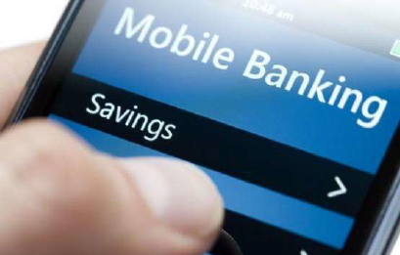
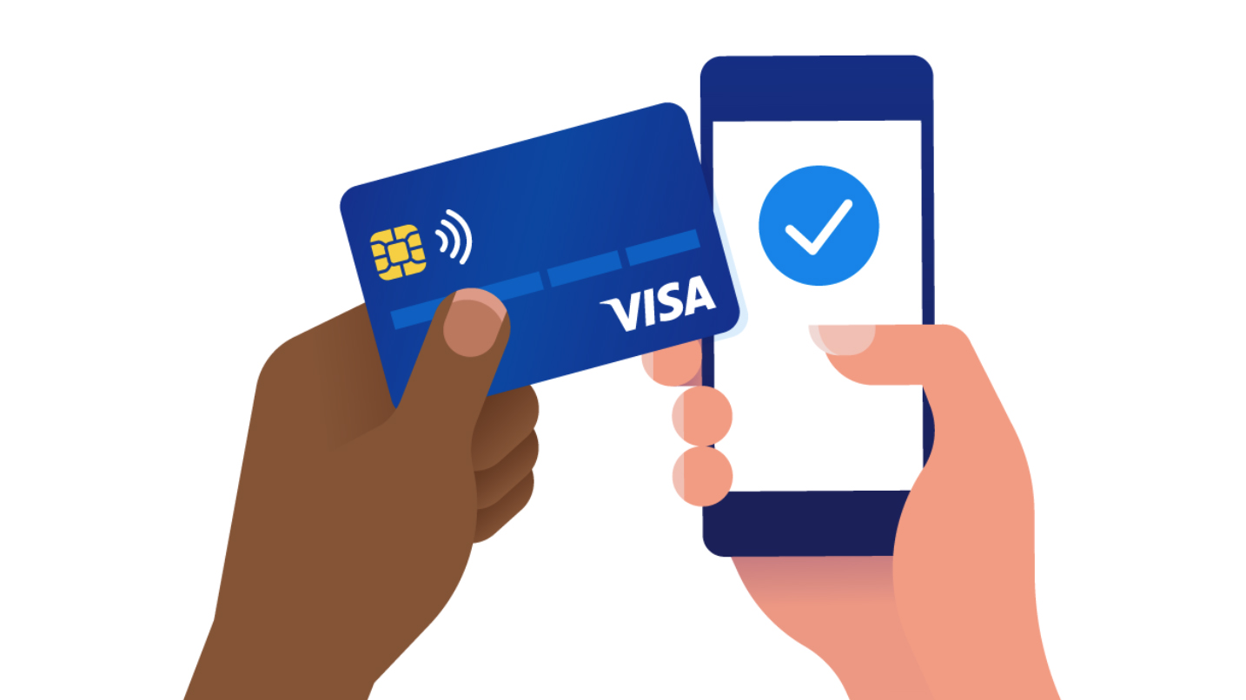
Financial services
Mobile Banking
Use of internet to meet your financial needs

Slide 12

Financial services
Agency banking
Agency banking is a model where licensed commercial banks offer financial services through appointed third-party agents (often retail shops, mobile money agents, petrol stations, etc.) instead of traditional bank branches.

Slide 13

Financial services
Internet banking
Internet banking, also known as online banking, is a service provided by banks that allows customers to perform financial transactions over the internet using a computer, smartphone, or tablet without visiting a bank branch.

Slide 14
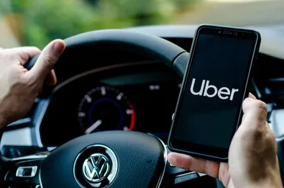
E-Transport services
Uber
Uber is a technology-based transportation platform that connects passengers with drivers of vehicles for hire through a mobile app or website. It operates in many countries around the world, including Uganda.

Slide 15

E-Transport services
Faras
Faras is a ride-hailing and delivery app similar to Uber and Bolt, developed and operated locally in Uganda. It connects passengers and customers with nearby drivers or riders (including cars, bodas, and tuk-tuks) through a mobile app.

Slide 16
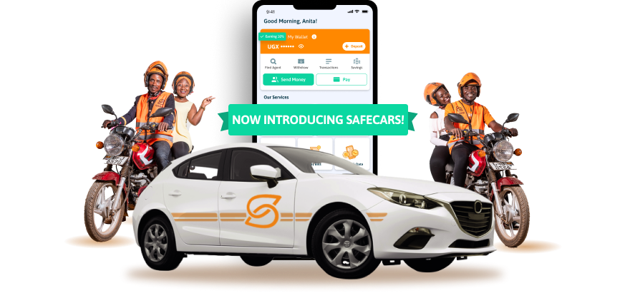
E-Transport services
Safecar/safeboda
SafeBoda/car is a ride-hailing and delivery platform based in Uganda, known for its safe, reliable motorcycle (boda) and car transport services. It is widely used in Kampala and other major towns.

Slide 17
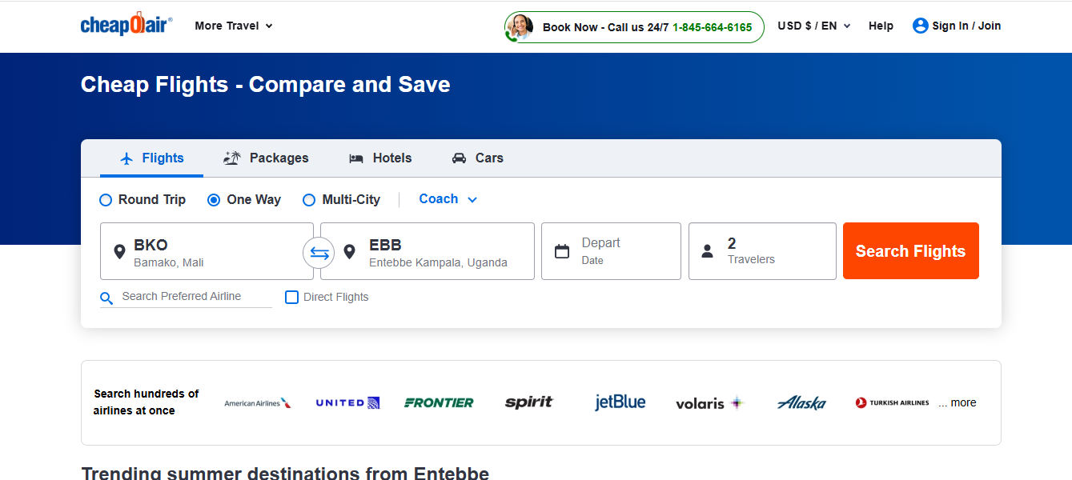
E-Ticket
Airticket
An E-plane ticket or electronic plane ticket (e-ticket) is a digital version of a traditional paper airline ticket. It allows travelers to book, pay for, and check in for flights online without needing a printed ticket.

Slide 18
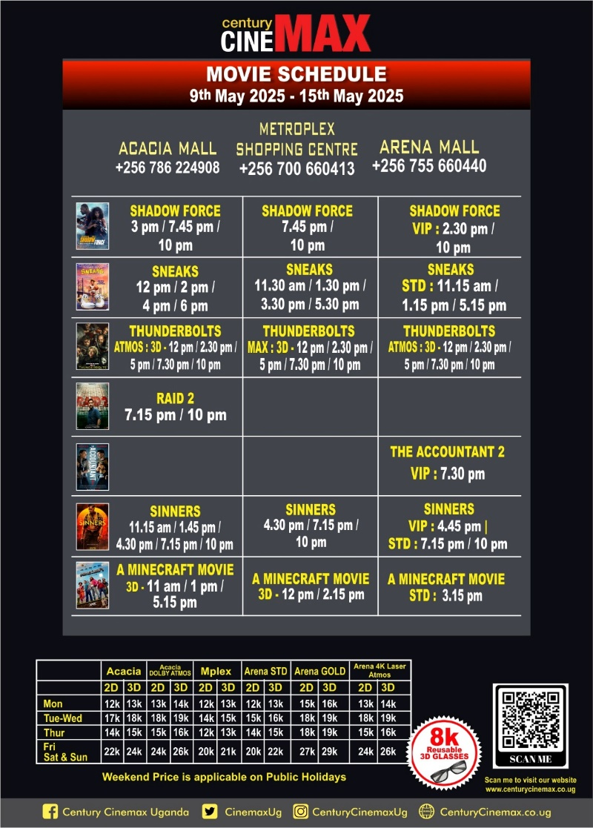
E-Ticket
Cinema
An e-cinema ticket is a digital or electronic movie ticket that allows you to book and pay for a cinema seat online using your phone, computer, or mobile app no need to print a physical ticket.

Slide 19
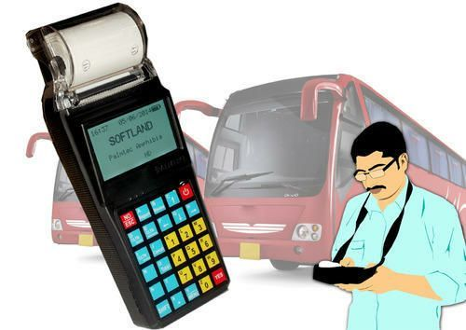
E-Ticket
Buses
An e-bus ticket is an electronic version of a traditional paper bus ticket, which allows passengers to book and pay for bus travel online using a phone, computer, or mobile app

Slide 20
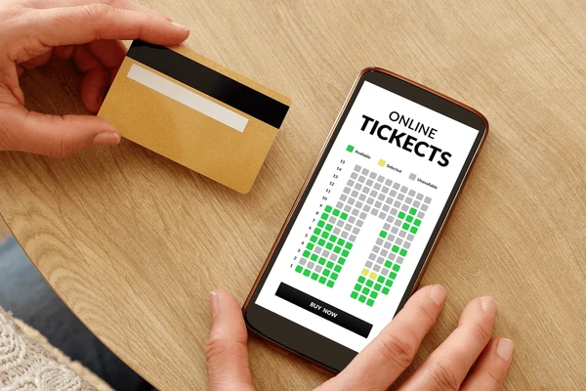
E-Ticket
Events/concerts
An e-event or e-concert ticket is an electronic or digital ticket used to gain entry to an entertainment event such as a concert, comedy show, festival, or conference. It is purchased online and delivered to your phone or email, allowing for paperless, convenient access.

Slide 21

Digital Observatory – What is it?
E-Government Services
The UG hub Systems Integration Platform so as to enable seamlessly sharing of data across Government systems

Slide 22
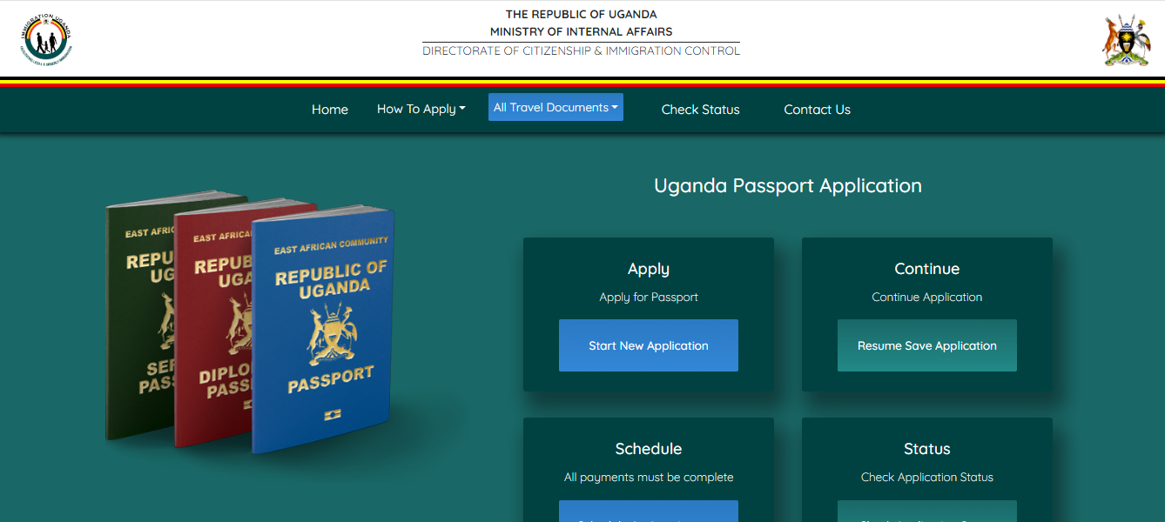
Digital Observatory – What is it?
E-government Services
Online passport registration:-
https://passports.go.ug/

Slide 23
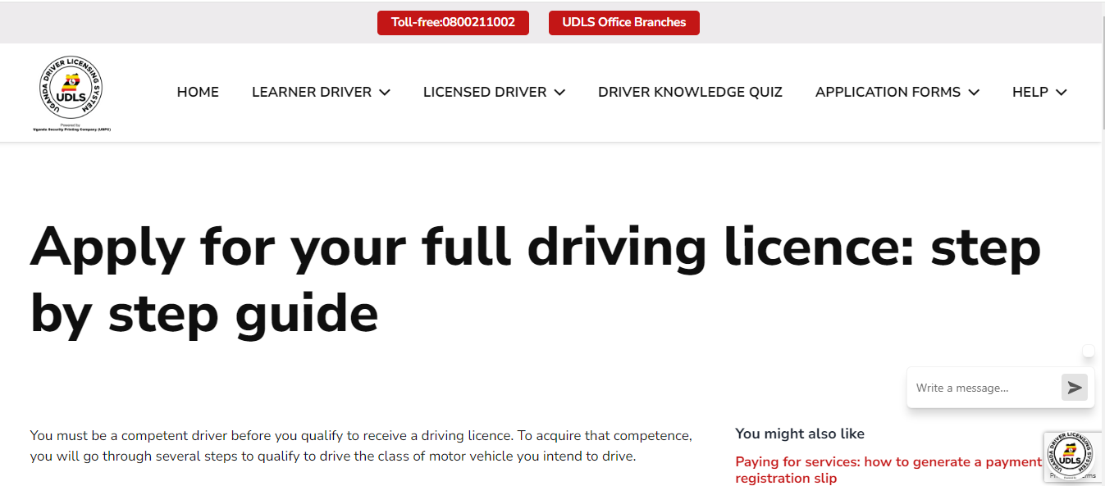
Digital Observatory – What is it?
E-government Services
Online driving permit registration:-
https://udls.co.ug/apply-for-your-full-driving-licence-step-by-step/

Slide 24
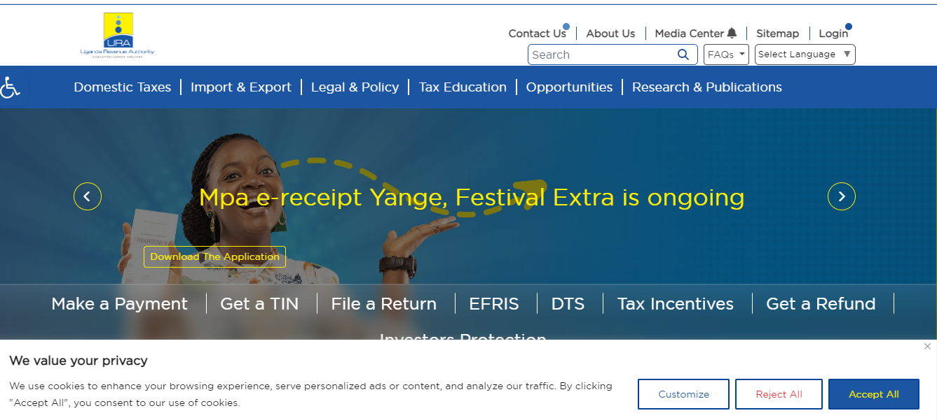
Digital Observatory – What is it?
E-government Services
Online Tax Payment
https://ura.go.ug/

Slide 25
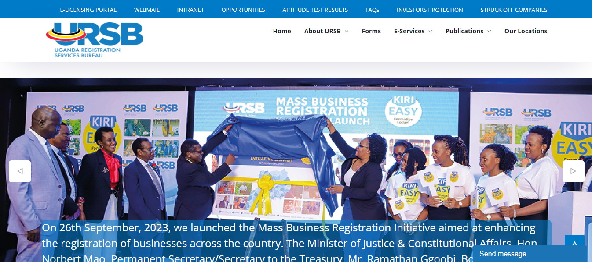
Digital Observatory – What is it?
E-government Services
Online Company Registration
https://ursb.go.ug/

Slide 26
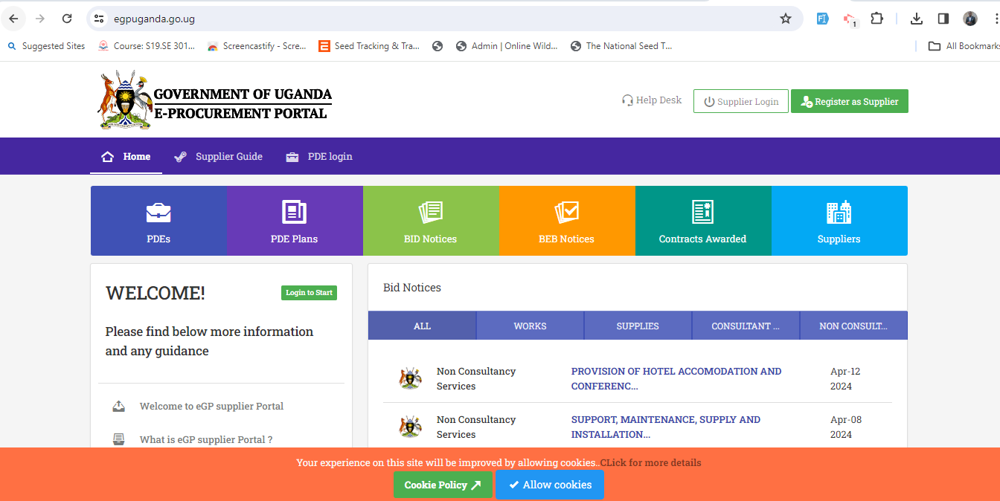
E-government Services
Electronic government procurement
https://egpuganda.go.ug/

Slide 27
Advantanges Of Digital Trasactions
Increased physical security
More convenient
Different options
Offers and discounts
Track your spending
Budget discipline
Save time and money

Slide 28
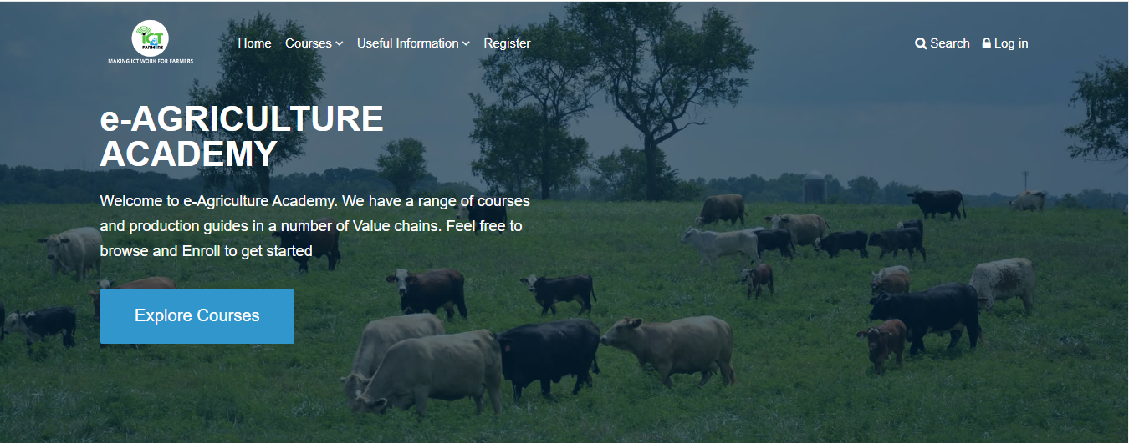
Agriculture Platform
The ICT4Farmers systems (UNFFE) The e-agric academy https://academy.unffeict4farmers.org/

Slide 29
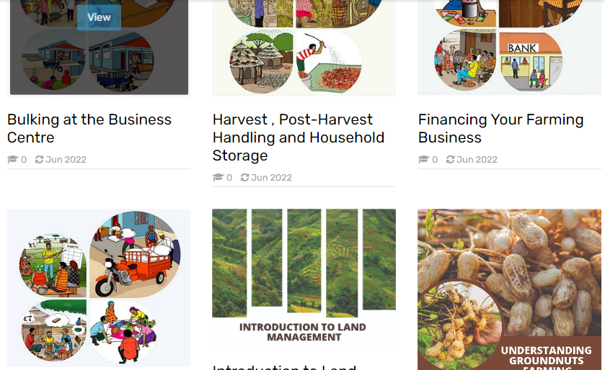
Agriculture Platform
The ICT4Farmers systems (UNFFE) The e-agric academy platform for agriculture lessons and reliable agriculture content

Slide 30
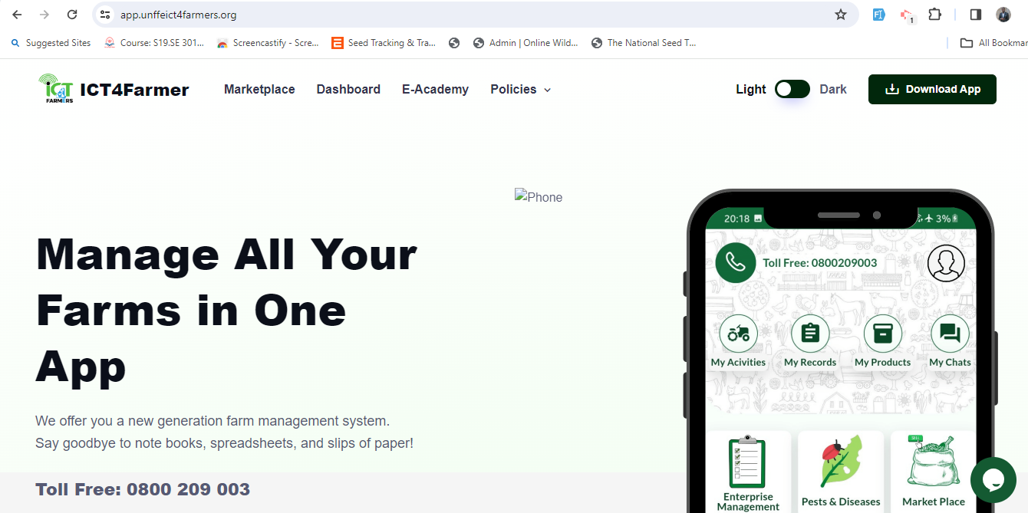
Agriculture Platform
The ICT4Farmers systems (UNFFE) The web system https://app.unffeict4farmers.org/

Slide 31
Agriculture Platform
The ICT4Farmers systems (UNFFE) The web system features
Farmers’ and service providers profiling
Garden registration and mapping
Farm records management
Weather information
Pest and Disease management
Market access services

Slide 32
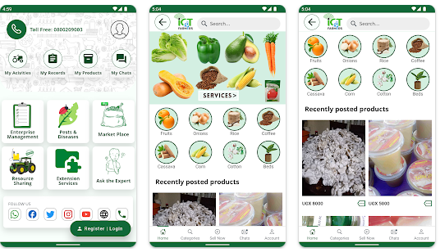
Agriculture Platform
The ICT4Farmers systems (UNFFE) Mobile App Google play store

Slide 33
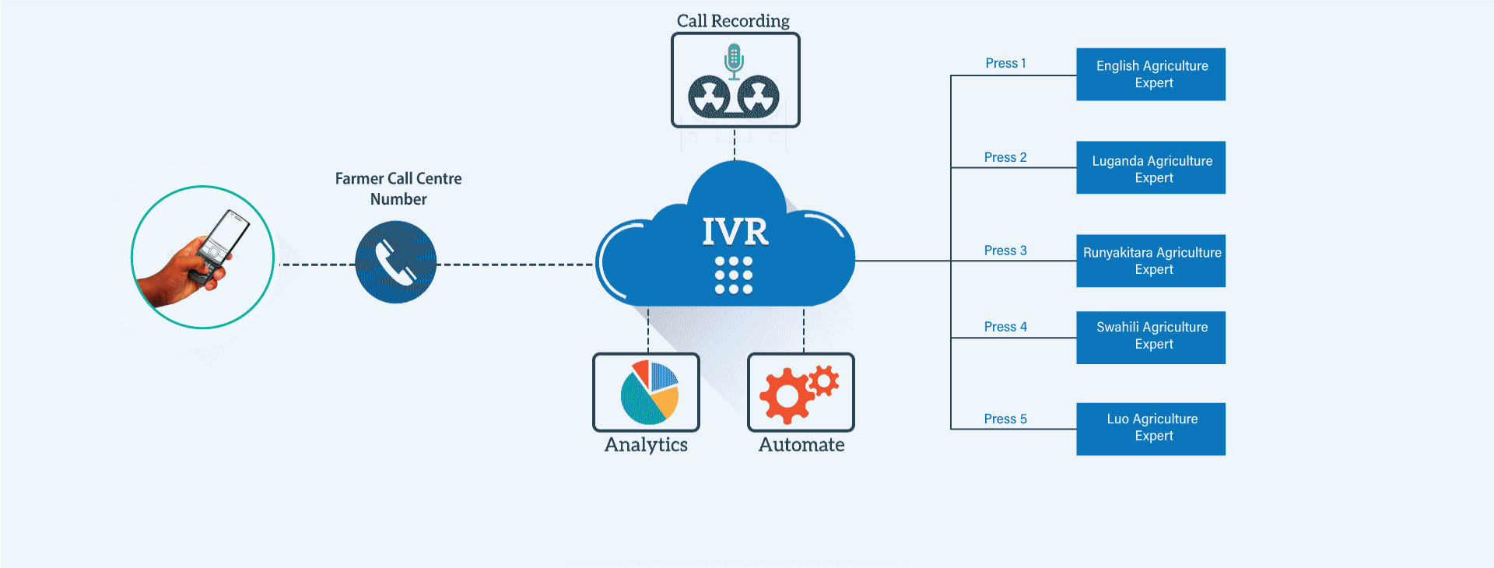
Agriculture Platform
The ICT4Farmers call Centre (UNFFE)
Dail…0800209003

Slide 34
Q&A

